Slide 1

ClarityUX
-
Visual Attention Analyzer
-
Chandra Prakash
Visual Attention Analyzer
AI-powered Chrome extension for advanced webpage attention analysis
Presented By
Chandra Prakash S

Slide 2
Problem Statement
Web designers and marketers struggle to predict where users will focus
Traditional eye-tracking studies are expensive and time-consuming
Need for accessible tools to understand visual attention patterns
Lack of solutions combining visual and structural webpage analysis
01

Slide 3
01.
Chrome extension that analyzes visual attention patterns on webpages
Solution Overview
02.
Combines computer vision with DOM analysis for comprehensive results
Provides interactive visualizations overlaid on the actual webpage
02
03.
Makes advanced attention analytics accessible to everyone

Slide 4
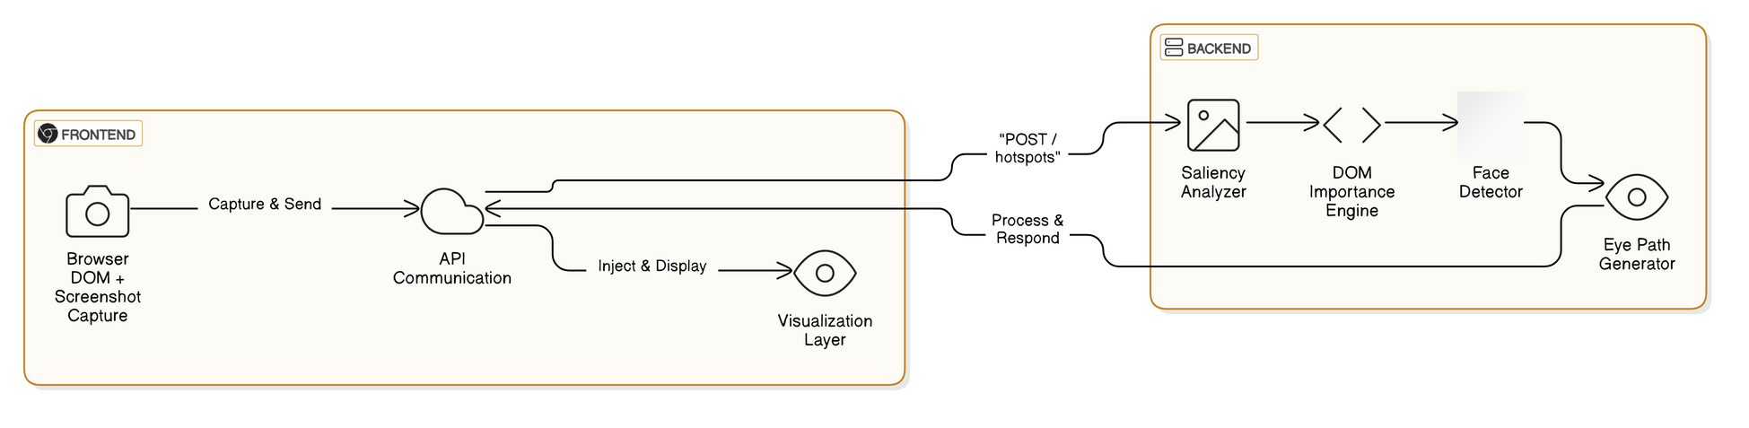
Technical Architecture
Frontend: Chrome Extension APIs (content scripts, background workers)
Screenshot Capture: Chrome tabs API for full page capture
DOM Analysis: JavaScript parsing of page structure and attributes
Backend Processing: FastAPI Python server with computer vision algorithms
Data Flow: Screenshot + DOM data → API → Visualization overlays
03

Slide 5
04
Spectral Residual Saliency Detection:
Identifies visually distinctive regions
Hybrid Scoring System:
Core Algorithms
Combines visual saliency with DOM importance
Center Bias Application:
Accounts for natural human tendency to focus on center
Non-Maximum Suppression:
MediaPipe Face Detection:
Merges overlapping regions for cleaner results
Prioritizes human faces in attention analysis

Slide 6

Visualization Features
Hotspot Regions: Color-coded boxes with rank indicators
Eye Movement Path: Numbered points with directional lines
Face Detection: Purple outlines identify faces as attention anchors
Attention Heatmap: Color-gradient overlay of attention distribution
Interactive Controls: Toggle visibility of different visualization layers
05

Slide 7
Code Deep Dive: Backend
FastAPI Framework: Efficient, async Python web server
Key Components:
Saliency detection with OpenCV
Center bias application for natural viewing patterns
DOM importance calculation (tag weights, position, content)
Face detection integration with MediaPipe
Hotspot scoring algorithm that balances visual and semantic signals
06

Slide 8
Code Deep Dive: Frontend
Extension Components:
Content script for DOM analysis and visualization rendering
Background script for screenshot capture
Interactive control panel for visualization toggles
Enhanced DOM Data Extraction:
Element positions, attributes, and styles
Interactive element detection
Visibility checking and DOM depth calculation
07

Slide 9


01
04
Accessibility specialists identifying focus issues
UX designers optimizing webpage layouts
Real-World Applications
02
Marketing teams improving ad and CTA placement
05
E-commerce sites optimizing product displays
Exploring creativity
08
03
Content creators enhancing visual hierarchy
06
News sites arranging content for maximum engagement

Slide 10

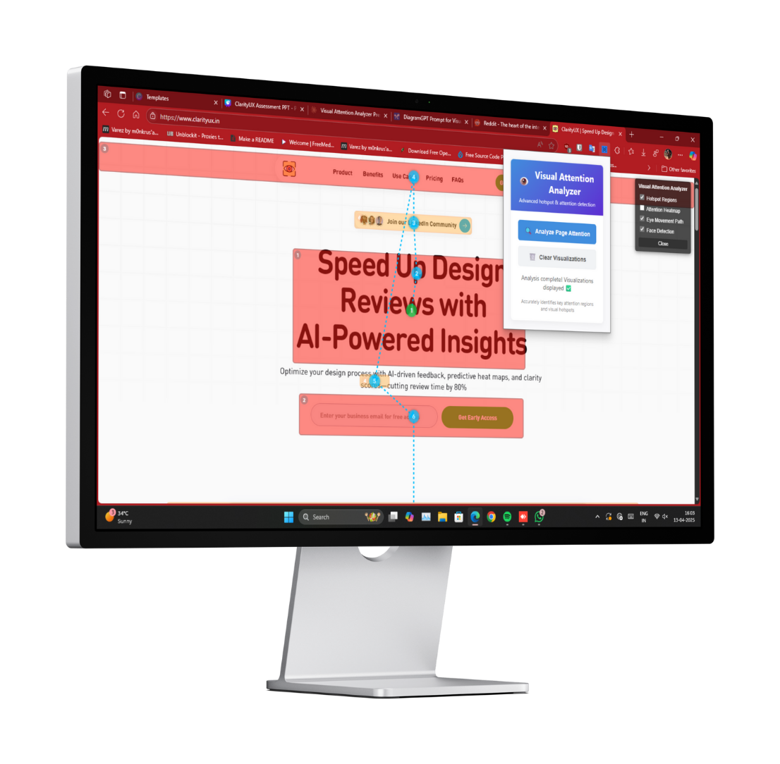
Screenshots
09

Slide 11
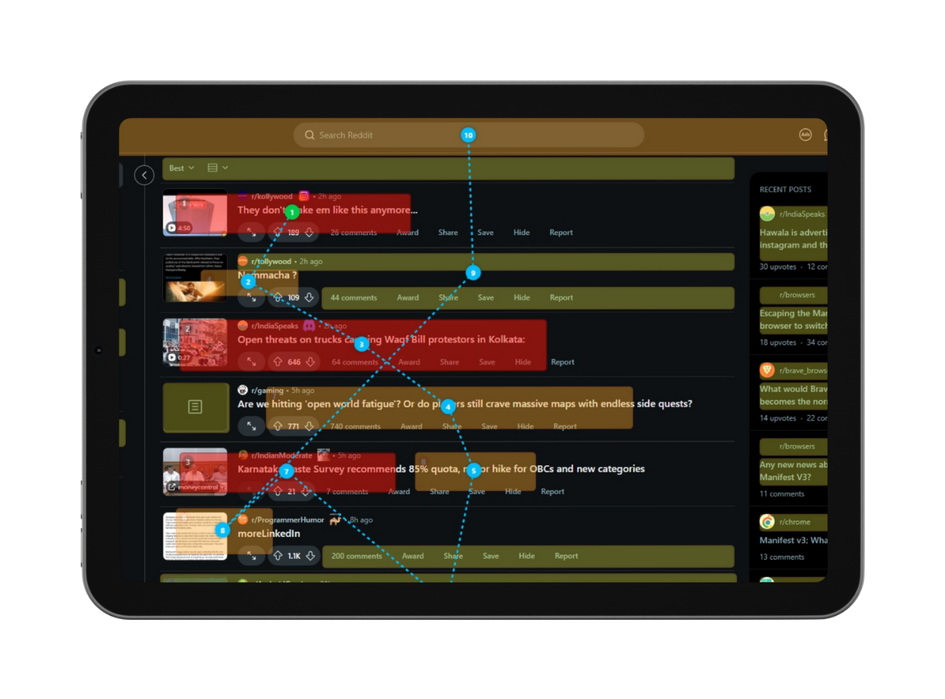
Screenshots
10

Slide 12

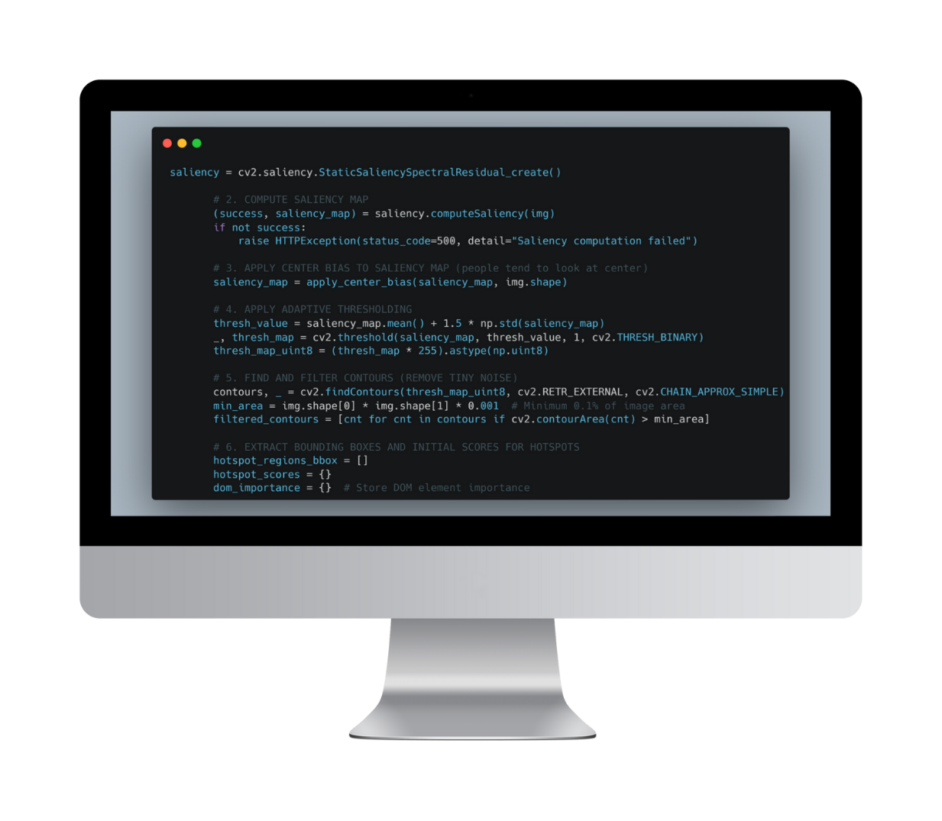
Code Snippet
11

Slide 13
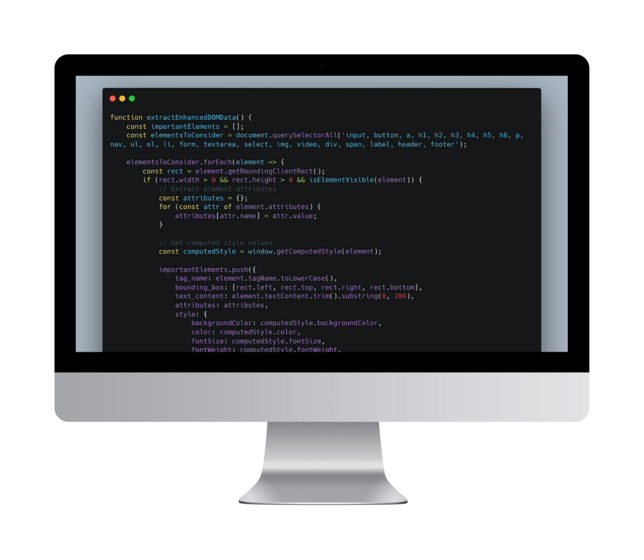
Code Snippet
12

Slide 14
01
Machine learning model to incorporate user behavior data
04
Mobile website/app support
Future Development
02
Comparative analysis between multiple webpage versions
05
Accessibility focus mode for inclusive design
Exploring creativity
03
06
13
Integration with design tools (Figma, Adobe XD)
API for integration with analytics platforms

Slide 15
14
Conclusion
Visual Attention Analyzer bridges the gap between design and user perception
Combines cutting-edge computer vision with website structure analysis
Provides actionable insights for design optimization
Open-source approach encourages community improvement

Slide 16
ClarityUX
-
Visual Attention Analyzer
-
Chandra Prakash
Thank You
Chandra Prakash

